Slide 1
Designing Packages, Symbols, and Devices

Slide 2
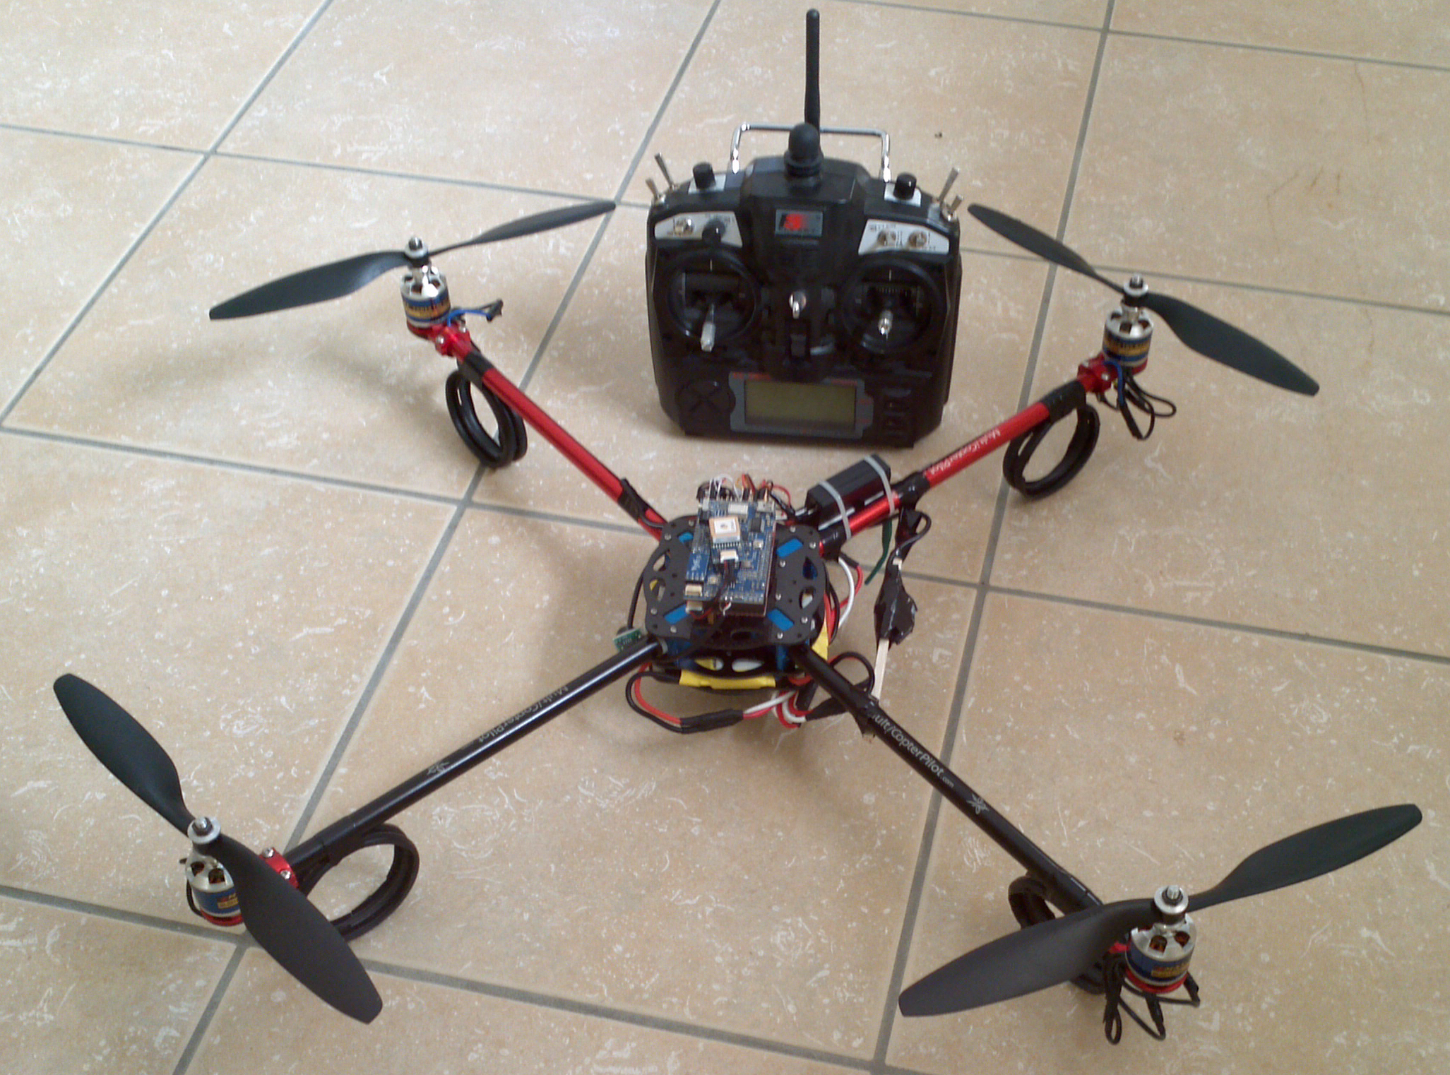


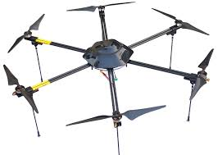
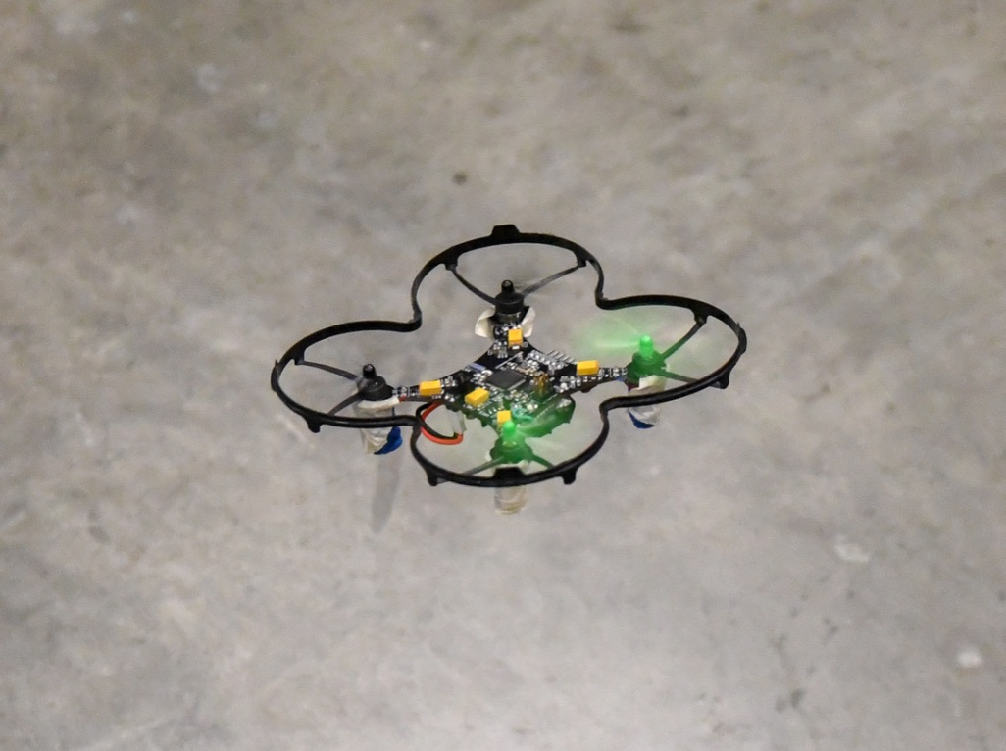


Slide 3
Multirotor Aircraft Components
Airframe
Structural support
Plastic, aluminum, wood, or PCB (fiberglass)
Motors
Lift, movement, and control
Brushed DC motors for small craft
Brushless brushless DC motors for large craft.
Inertial Measurement Unit (IMU)
Sensing the aircraft’s orientation and movement
Gyroscopes and accelerometers.
Computing resources (microcontroller/processor)
To run the flight control software
Manage communication
Flight control software
Provides stability using the IMU and motors
Converts pilot commands to motor outputs
Radio
For receiving command
Returning telemetry.
Power supply
Lots of power for the motors
Carefully regulated power for the IMU and micro controller.

Slide 4
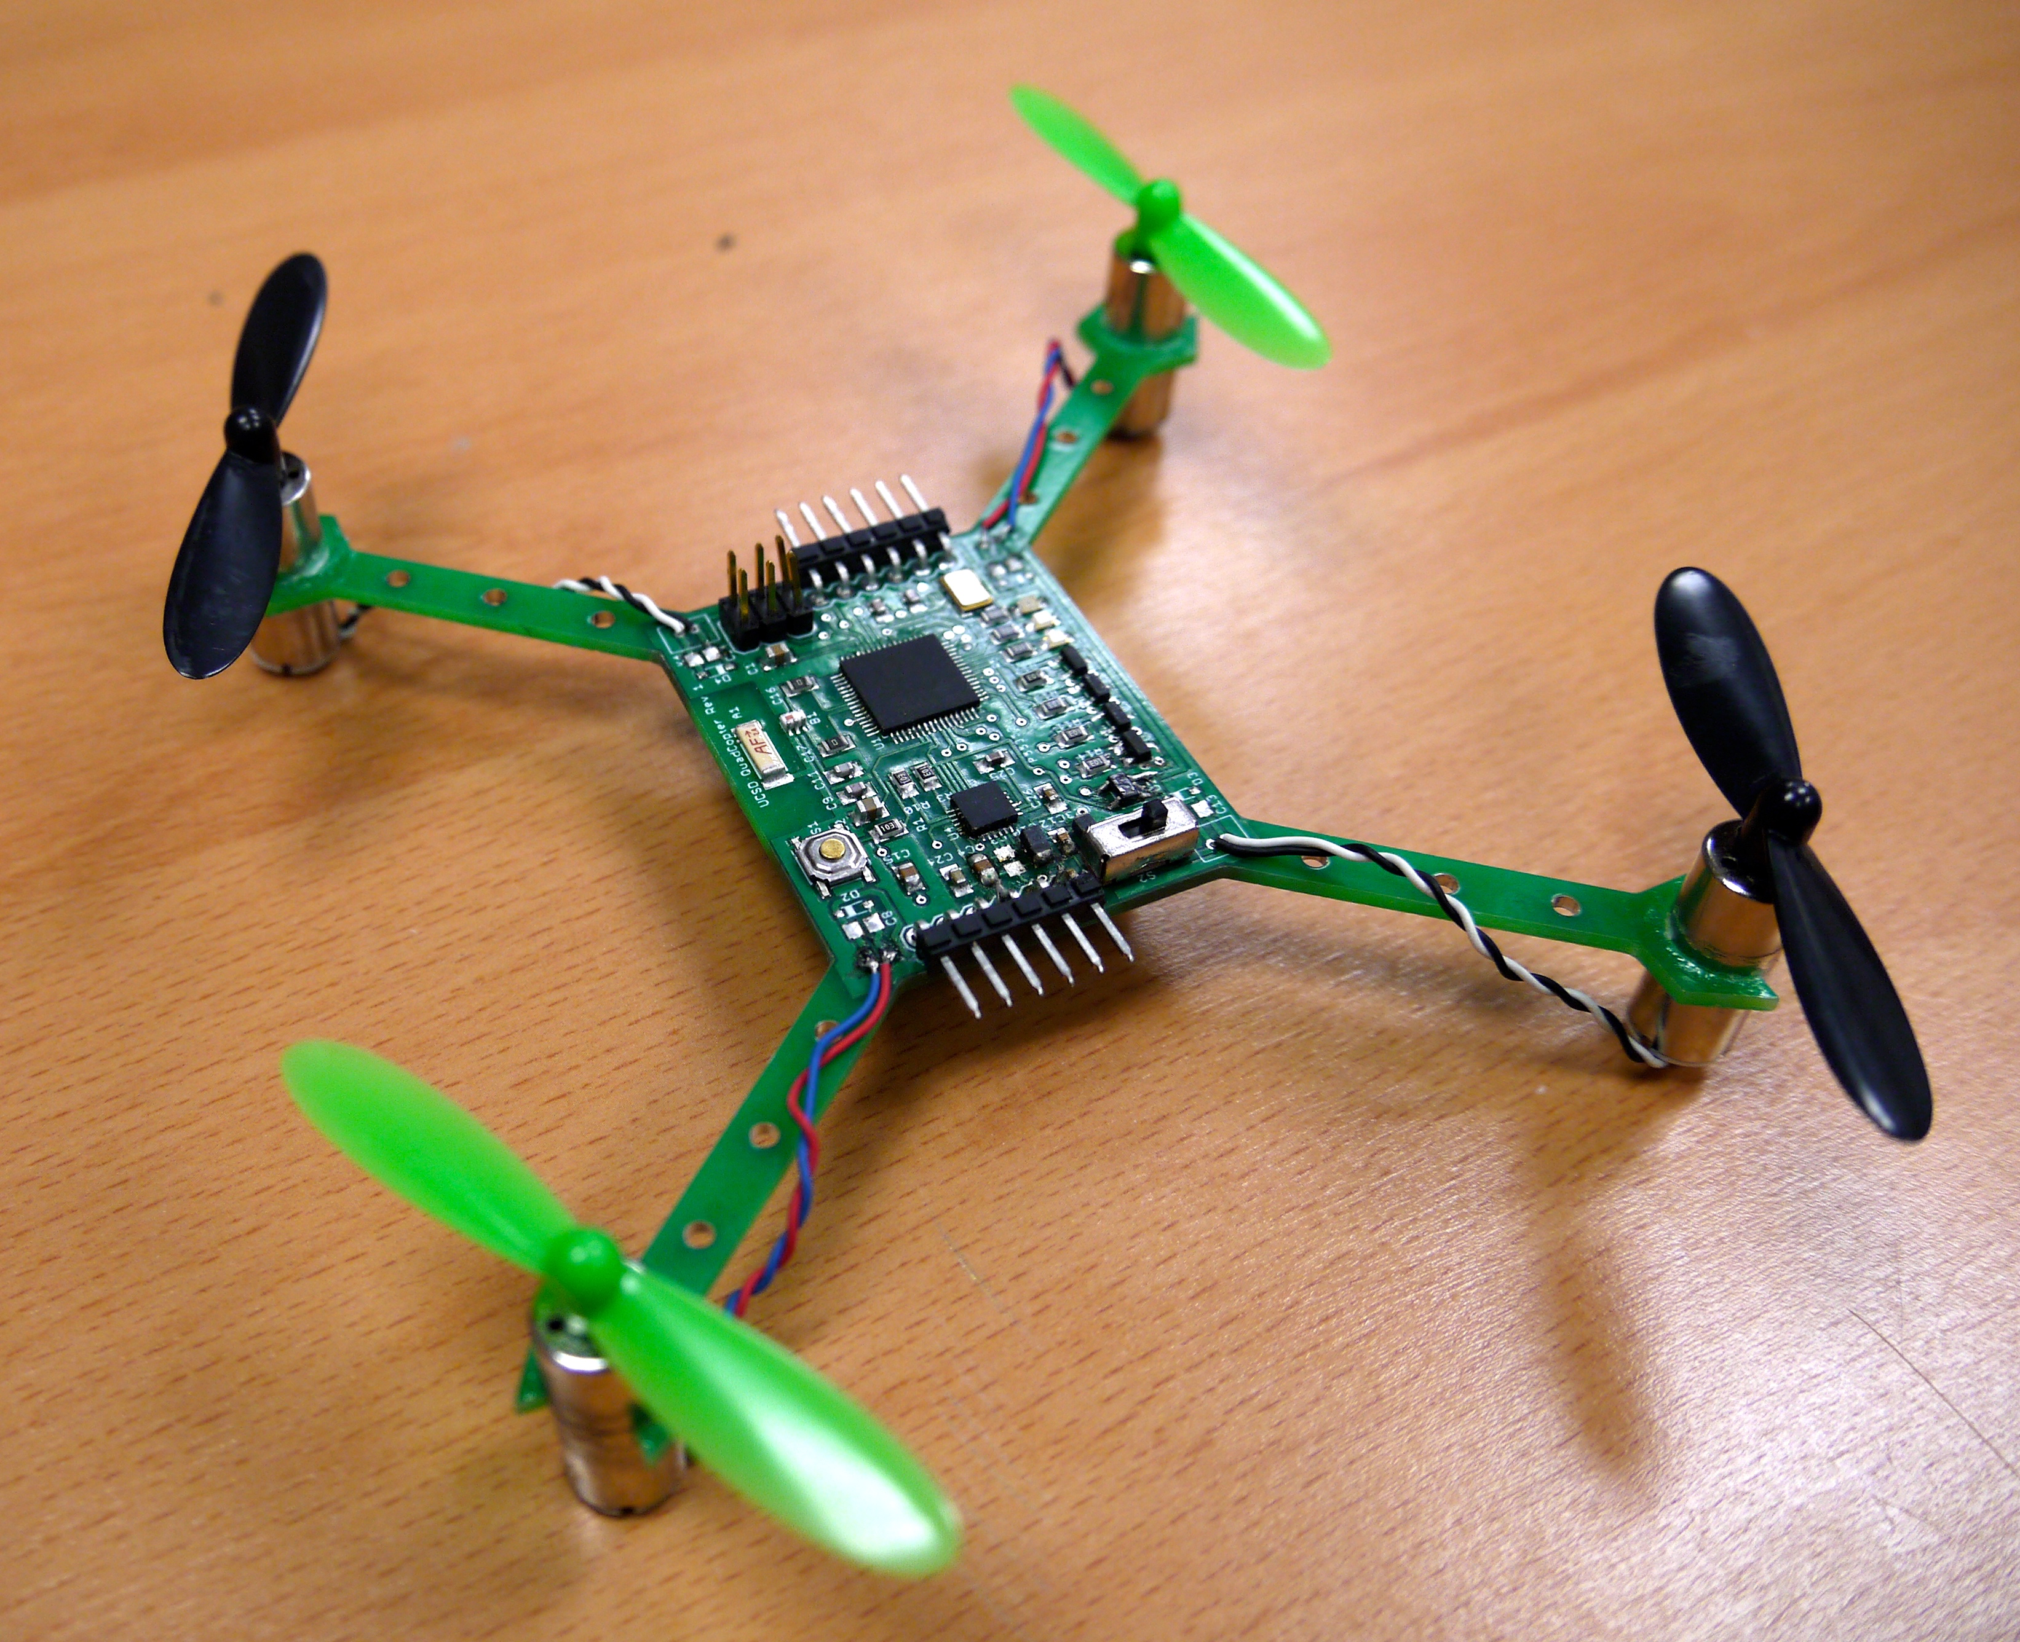
The Hardware You will Build

Slide 5
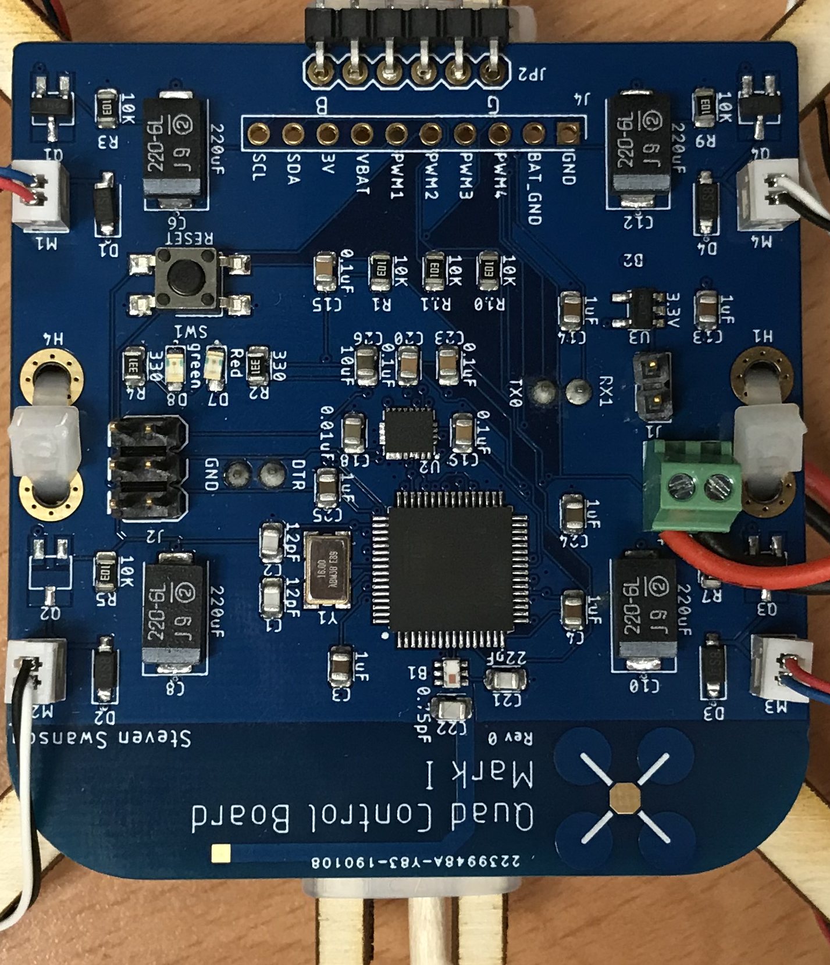
The Hardware You Will Build

Slide 6
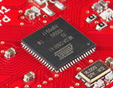
Flight Computer
ATmega128RFA1 microcontroller
Arduino compatible
16Mhz clock
128KB Flash
16KB SRAM
4096B EEPROM
2.4GHz radio

Slide 7
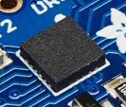
Inertial Measurement Unit
STMicro LSM9DS1
9-axis sensor
3-axis accelerometer
3-axis magnetometer
3-axis gyroscope
I2C interface (more on this later)

Slide 8
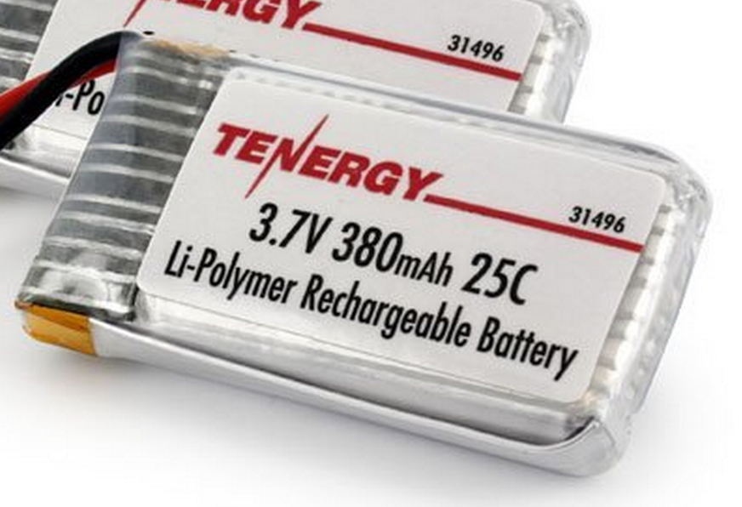
Power Supply
Lithium Polymer Battery
370 Mah
Max 9.25 Amps
Nominal voltage = 3.7V
Powers the motors directly
3.3V low dropout (LDO) voltage regulator
Powers the microcontroller and the IMU

Slide 9

Motors and Props
DC brushed motors
2 Amps max
Plenty of power

Slide 10
Designing Through-hole Pads
The diameter of the hole is smaller than the drilled hole
You need to add about 0.1-0.3 mm to the desired, plated internal diameter to get the drill diameter

Slide 11
PCB Libraries
To use a part on a PCB, you need a library entry for it
Physical/mechanical information for the board
Logical/electrical information for the schematic
Mapping between the two
Metadata
A well designed library, will make your life much, much easier.
There are lots of libraries are the internet
Some are good, some are bad, some a poor match for what we need.

Slide 12
Designing for Correctness
It’s very easy to introduce bugs in your library
This is no time for creativity
Copy/mimic as much as you can
Pin names
Pin order
Part orientation
This minimizes errors and makes it easy to check

Slide 13
Libraries
Libraries define the parts you can add to a PCB
Eagle libraries contain 3 different kinds of entities
Schematic Symbols – The symbolic version of the part
Package – The physical description of the part and how it should appear on the board
Device – A combination of a package and a schematic

Slide 14
Units
Units
We will mostly use mm in this class.
1mm is about 40mils (39.3700787, actually)
1in is 25.4 mm.
Keep an eye on your units.
Exceptions
Lots of tutorials, documents, etc. use mils (1/1000 of an inch) or inches.
Breadboards and headers are typically 0.1” spacing (2.54mm)
Mars Climate Orbiter

Slide 15
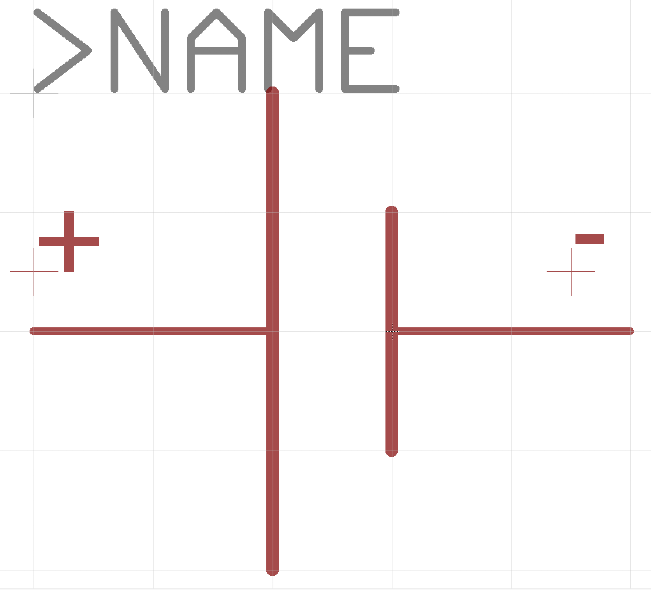
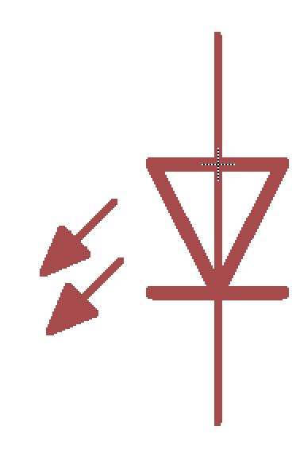
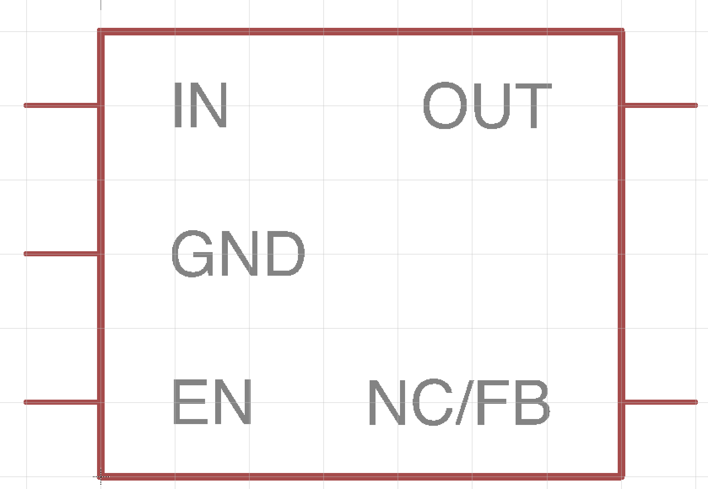
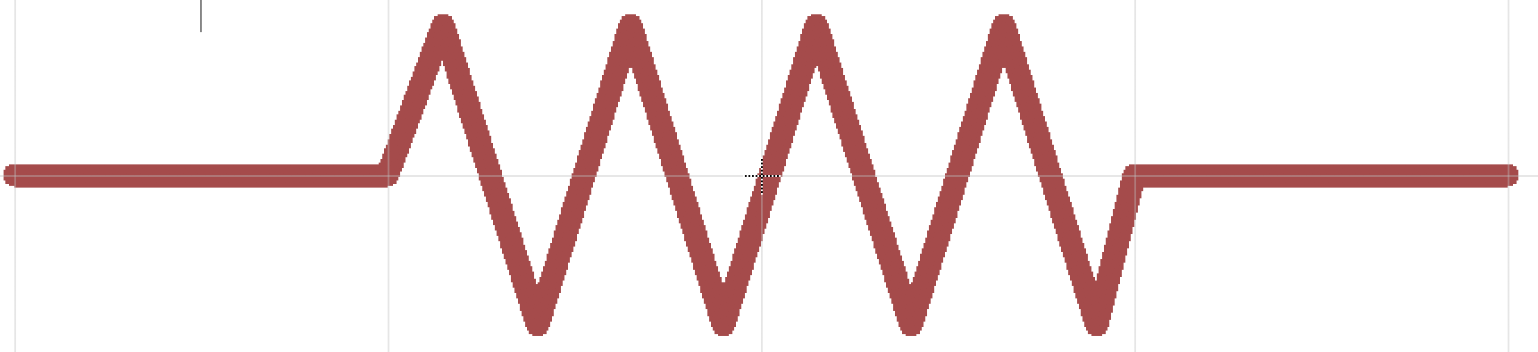
PCB Libraries: Symbols
Schematic representation of the component
Electrical connection points – “pins”
Generic symbols: resistors, capacitors, etc.
Specific symbols: e.g., Atmega128RF
Documentation, labels, etc.
Organized for ease of use and readability

Slide 16
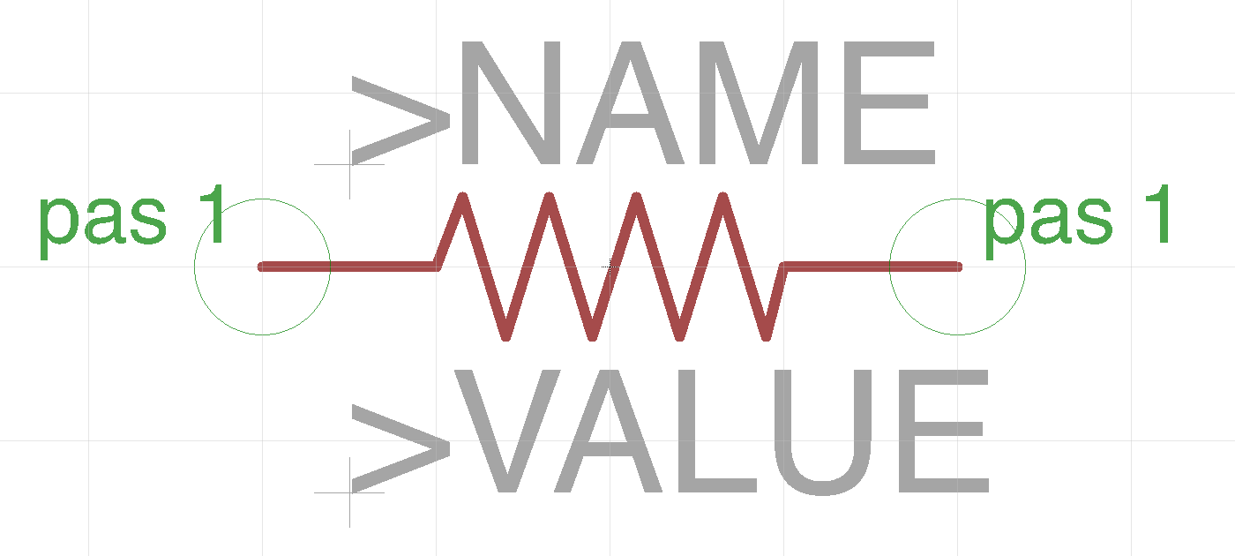
Example: A Resistor Symbol
Human-readable representation of the part
Has the standard resistor “zig zag”
Two ‘pins’
Pas 1
Pas 2
And place holders for documentation
>NAME – e.g. “R6”
>VALUE – e.g. “200Ohms”

Slide 17
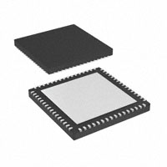
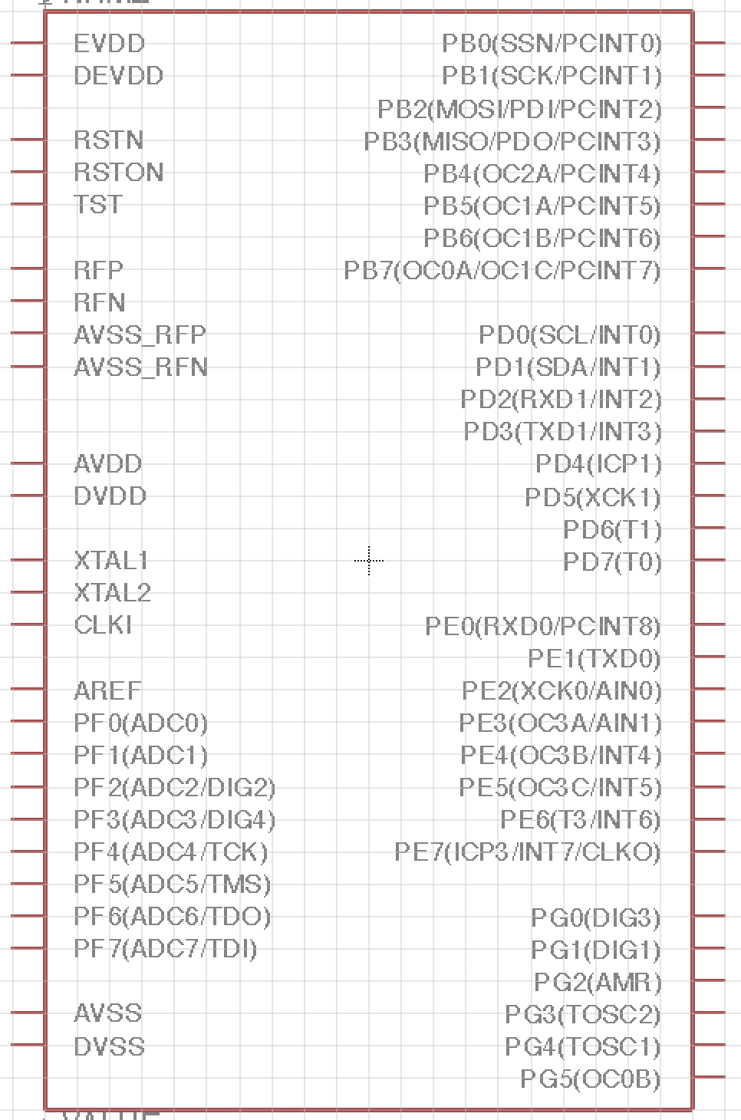
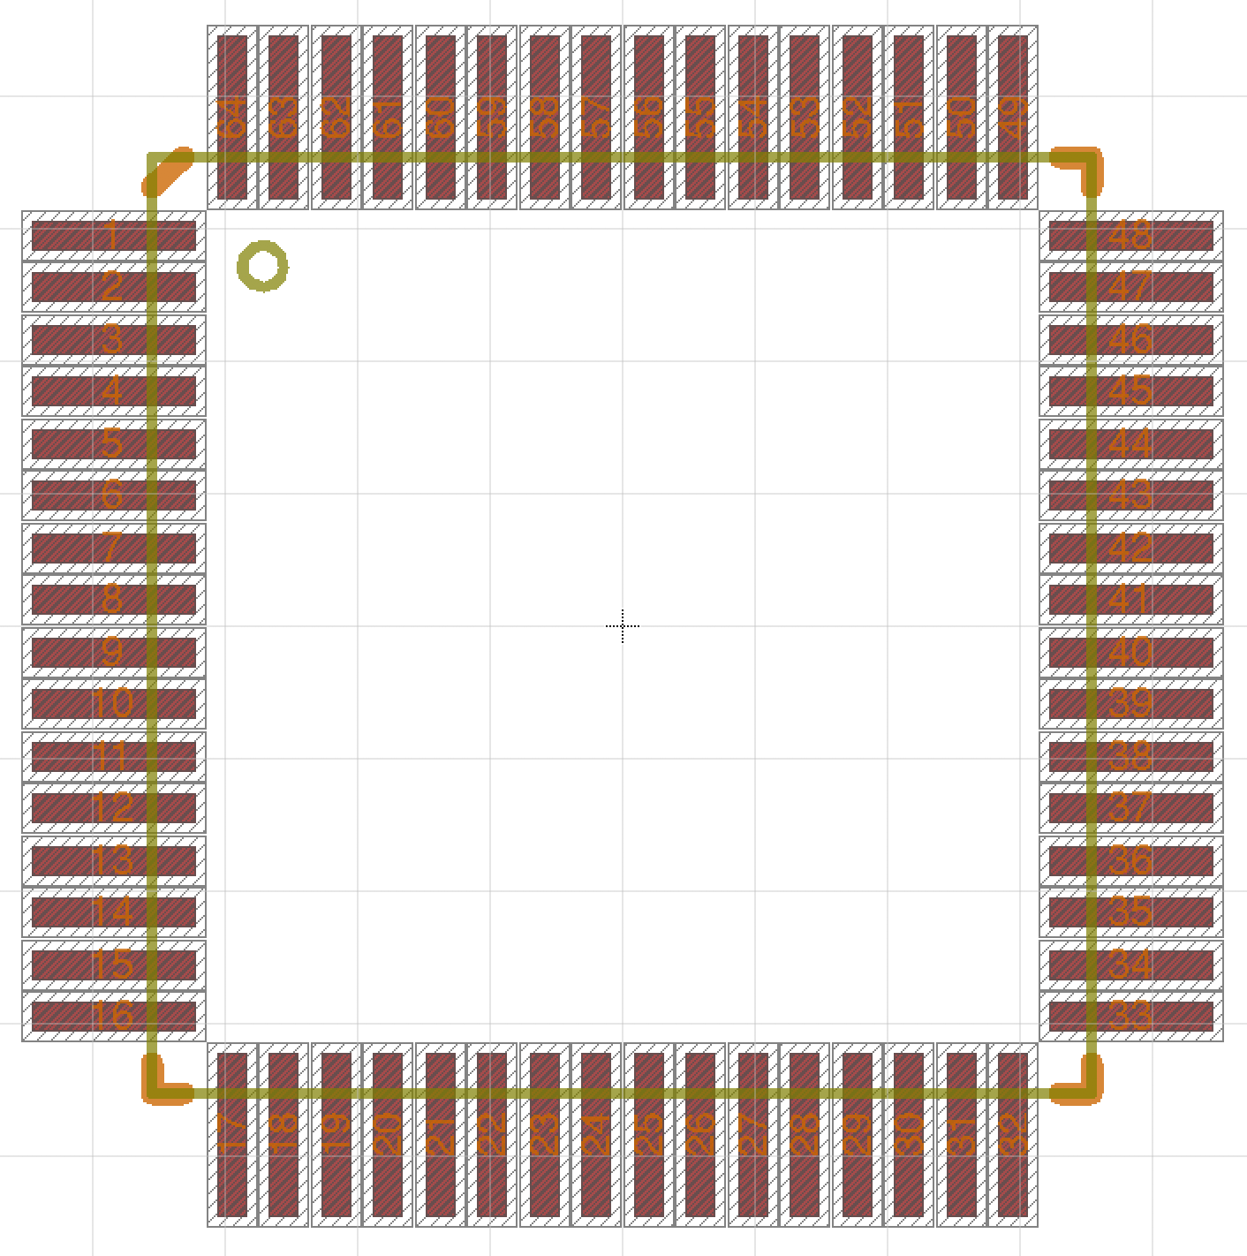
Physical part
Package
Device Pin Mapping
Symbol

Slide 18
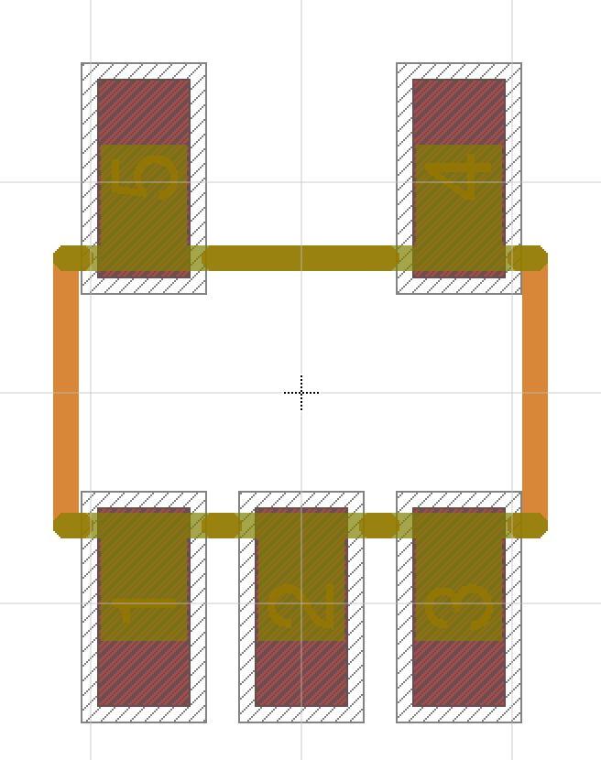
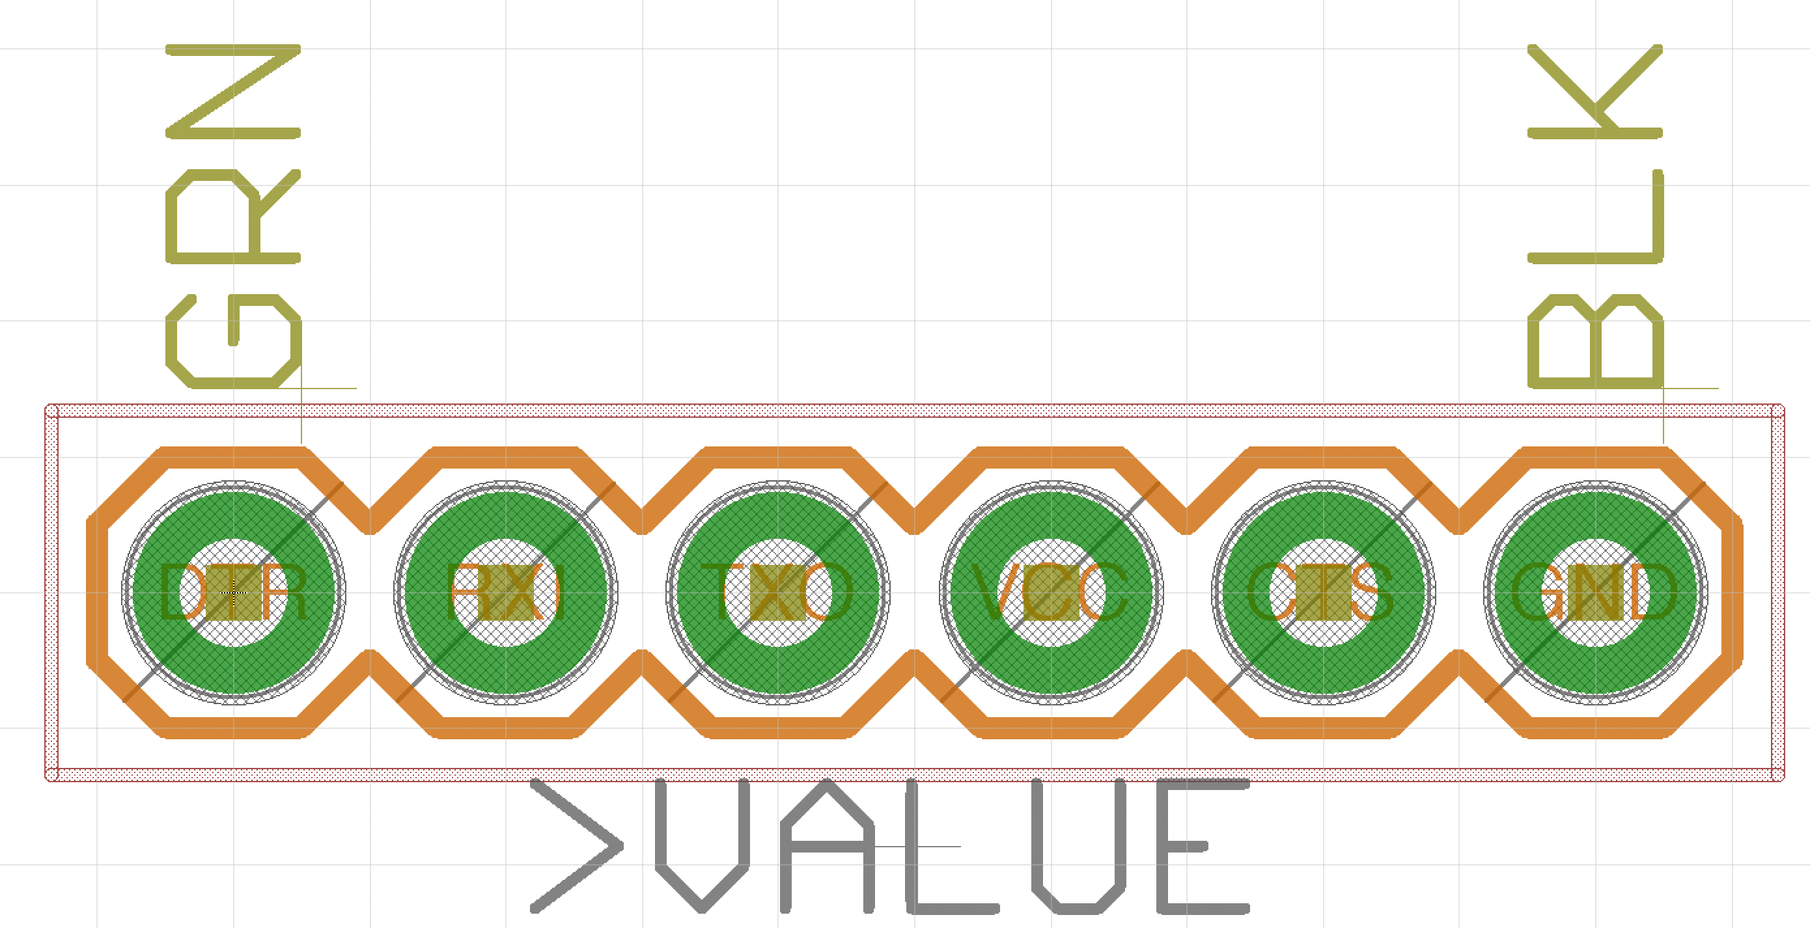
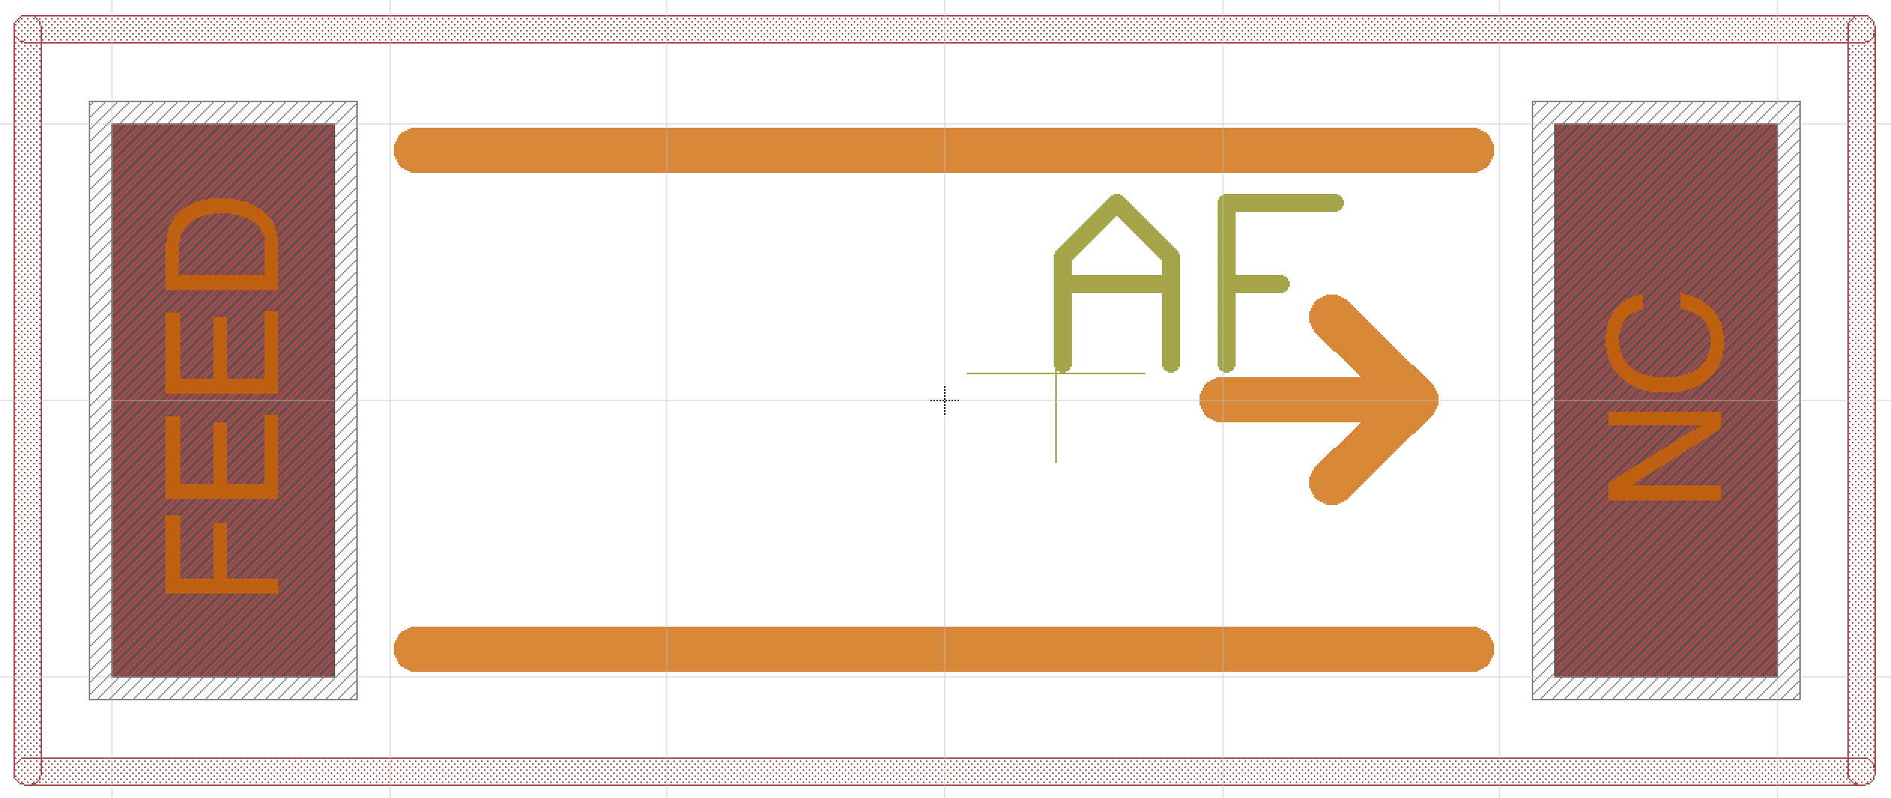
PCB Libraries: Packages
Mechanical description of the part
Electrical connections (i.e., pads and SMDs)
Generic packages: e.g., 0805 Resistor
Specific packages: e.g., Atmegat128RF

Slide 19
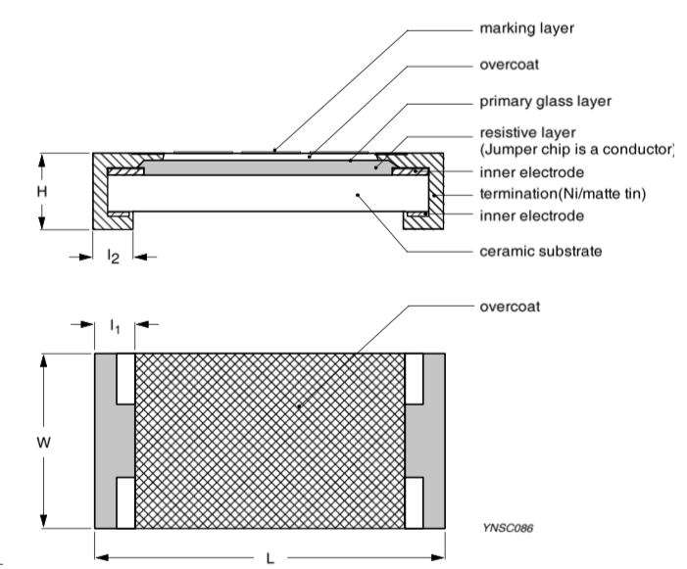
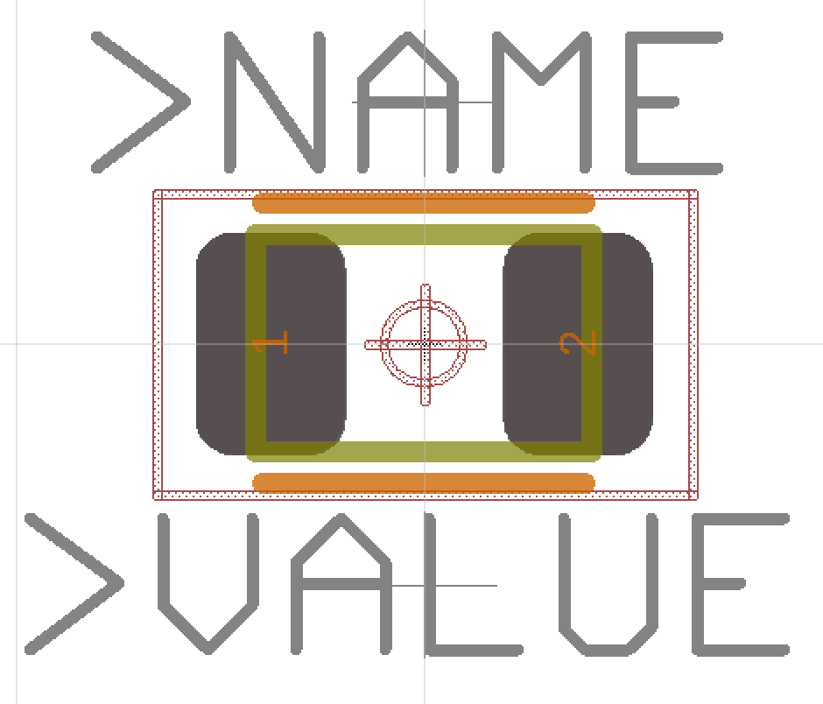
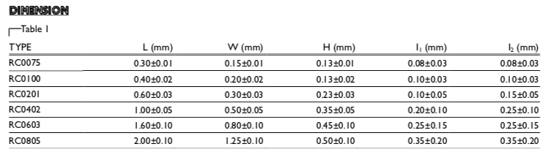
Example: A Resistor Package
Yageo RC Series SMD resistor
Package: 0805
Pads
Extend out 1mm or so for easy soldering.
Keep out area (court yard)
Where other parts should not be

Slide 20
Anatomy of a Package (Resistor)
Pins
Ex. “1” and “2”
Outline
In tDocu (gold)
Matches part shape precisely
Orientation/placement guidance
in tPlace (orange)
Varies by part.
Name
In tNames
Magic value “>NAME”
See lab for font size
Value
In tValues
Magic value “>VALUE”
See lab for font size
Keepouts
In tKeepout
Red shaded
Documentation
In tPlace
Other useful items

Slide 21
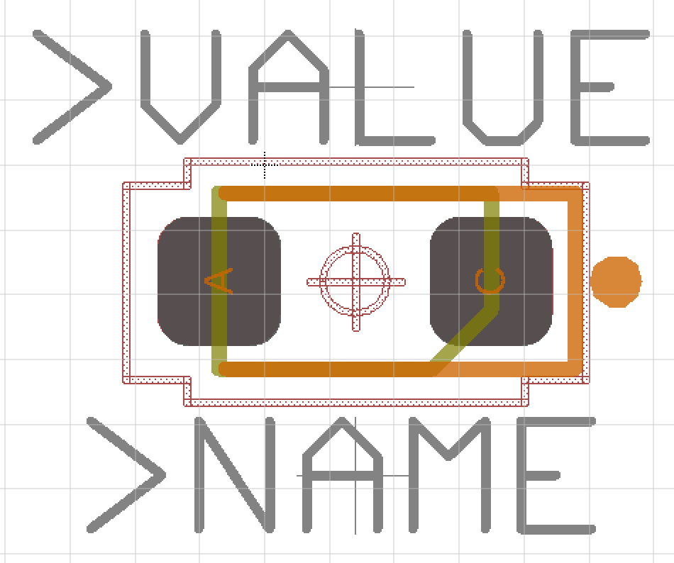
Anatomy of a Package (LED)
Pins
Outline
In tDocu (gold)
Matches part shape precisely
Orientation/placement guidance
in tPlace (orange)
Mark pin 1
Name
In tNames
Magic value “>NAME”
See lab for font size
Value
In tValues
Magic value “>VALUE”
See lab for font size
Keepouts
In tKeepout
Red shaded
Documentation
In tPlace
Other useful items

Slide 22
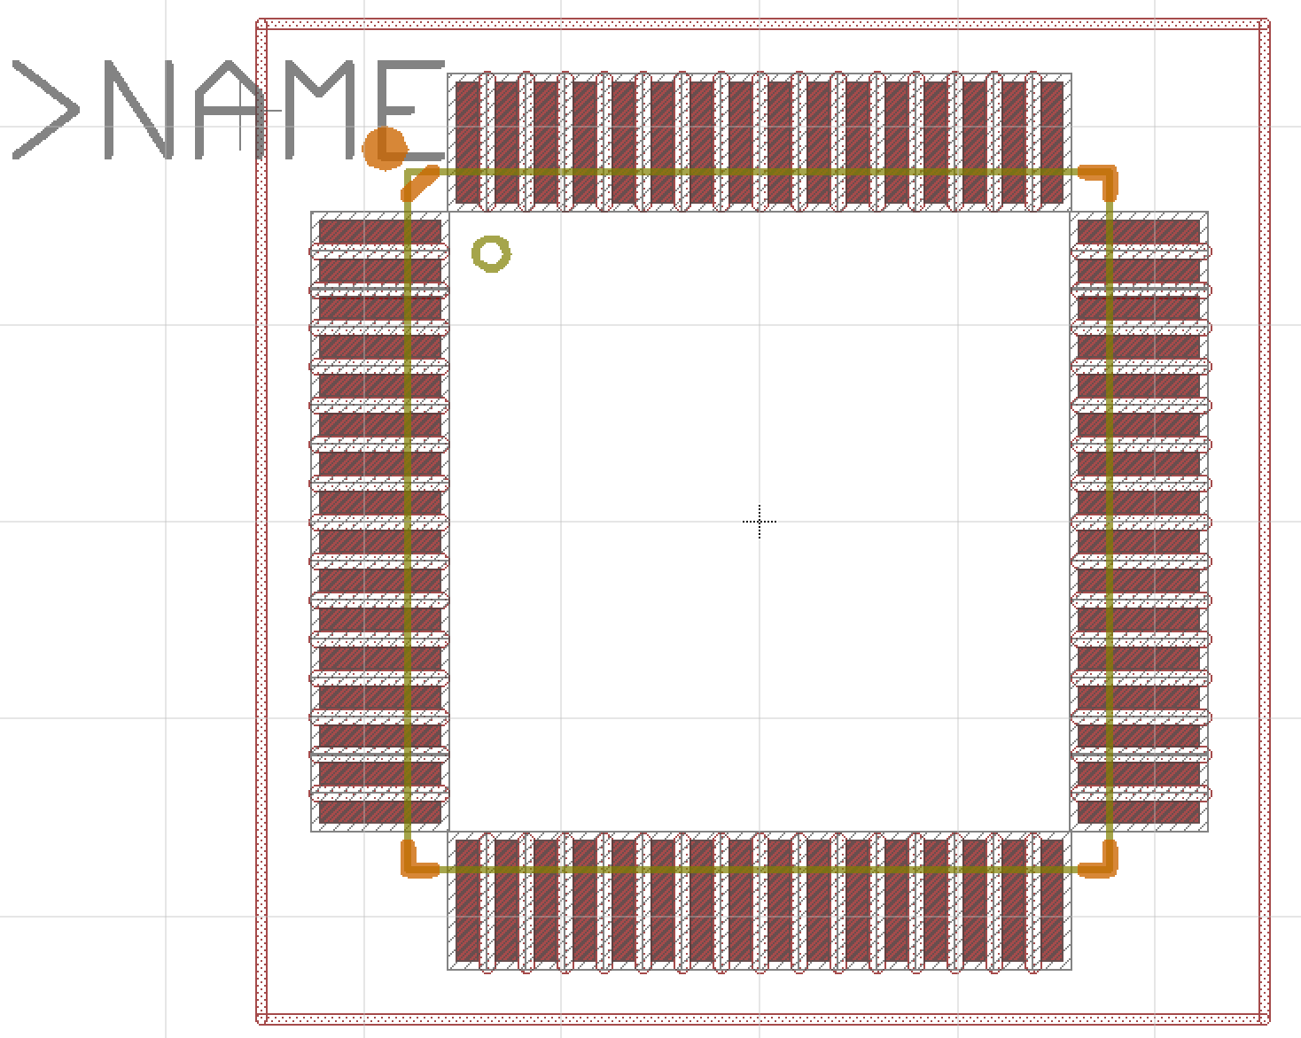
Anatomy of a Package (Microcontroller)
Pins
Outline
In tDocu (gold)
Matches part shape precisely
Orientation/placement guidance
in tPlace (orange)
Mark pin 1
Name
In tNames
Magic value “>NAME”
See lab for font size
Value
In tValues
Magic value “>VALUE”
See lab for font size
Keepouts
In tKeepout
Red shaded
Documentation
In tPlace
Other useful items

Slide 23
PCB Libraries: Devices
Devices map between
1 symbol
>= 1 packages
For each package, the device maps the schematic pins to the package pads/SMDs.
Metadata
“attributes” -- E.g., Manufacturer, part number, etc.
Name prefix for reference designators -- e.g, the “R” in R1, R2, etc.
Does it have a “value” (e.g., a resistor’s value is it’s resistance, but a microcontroller doesn’t have a value)

Slide 24
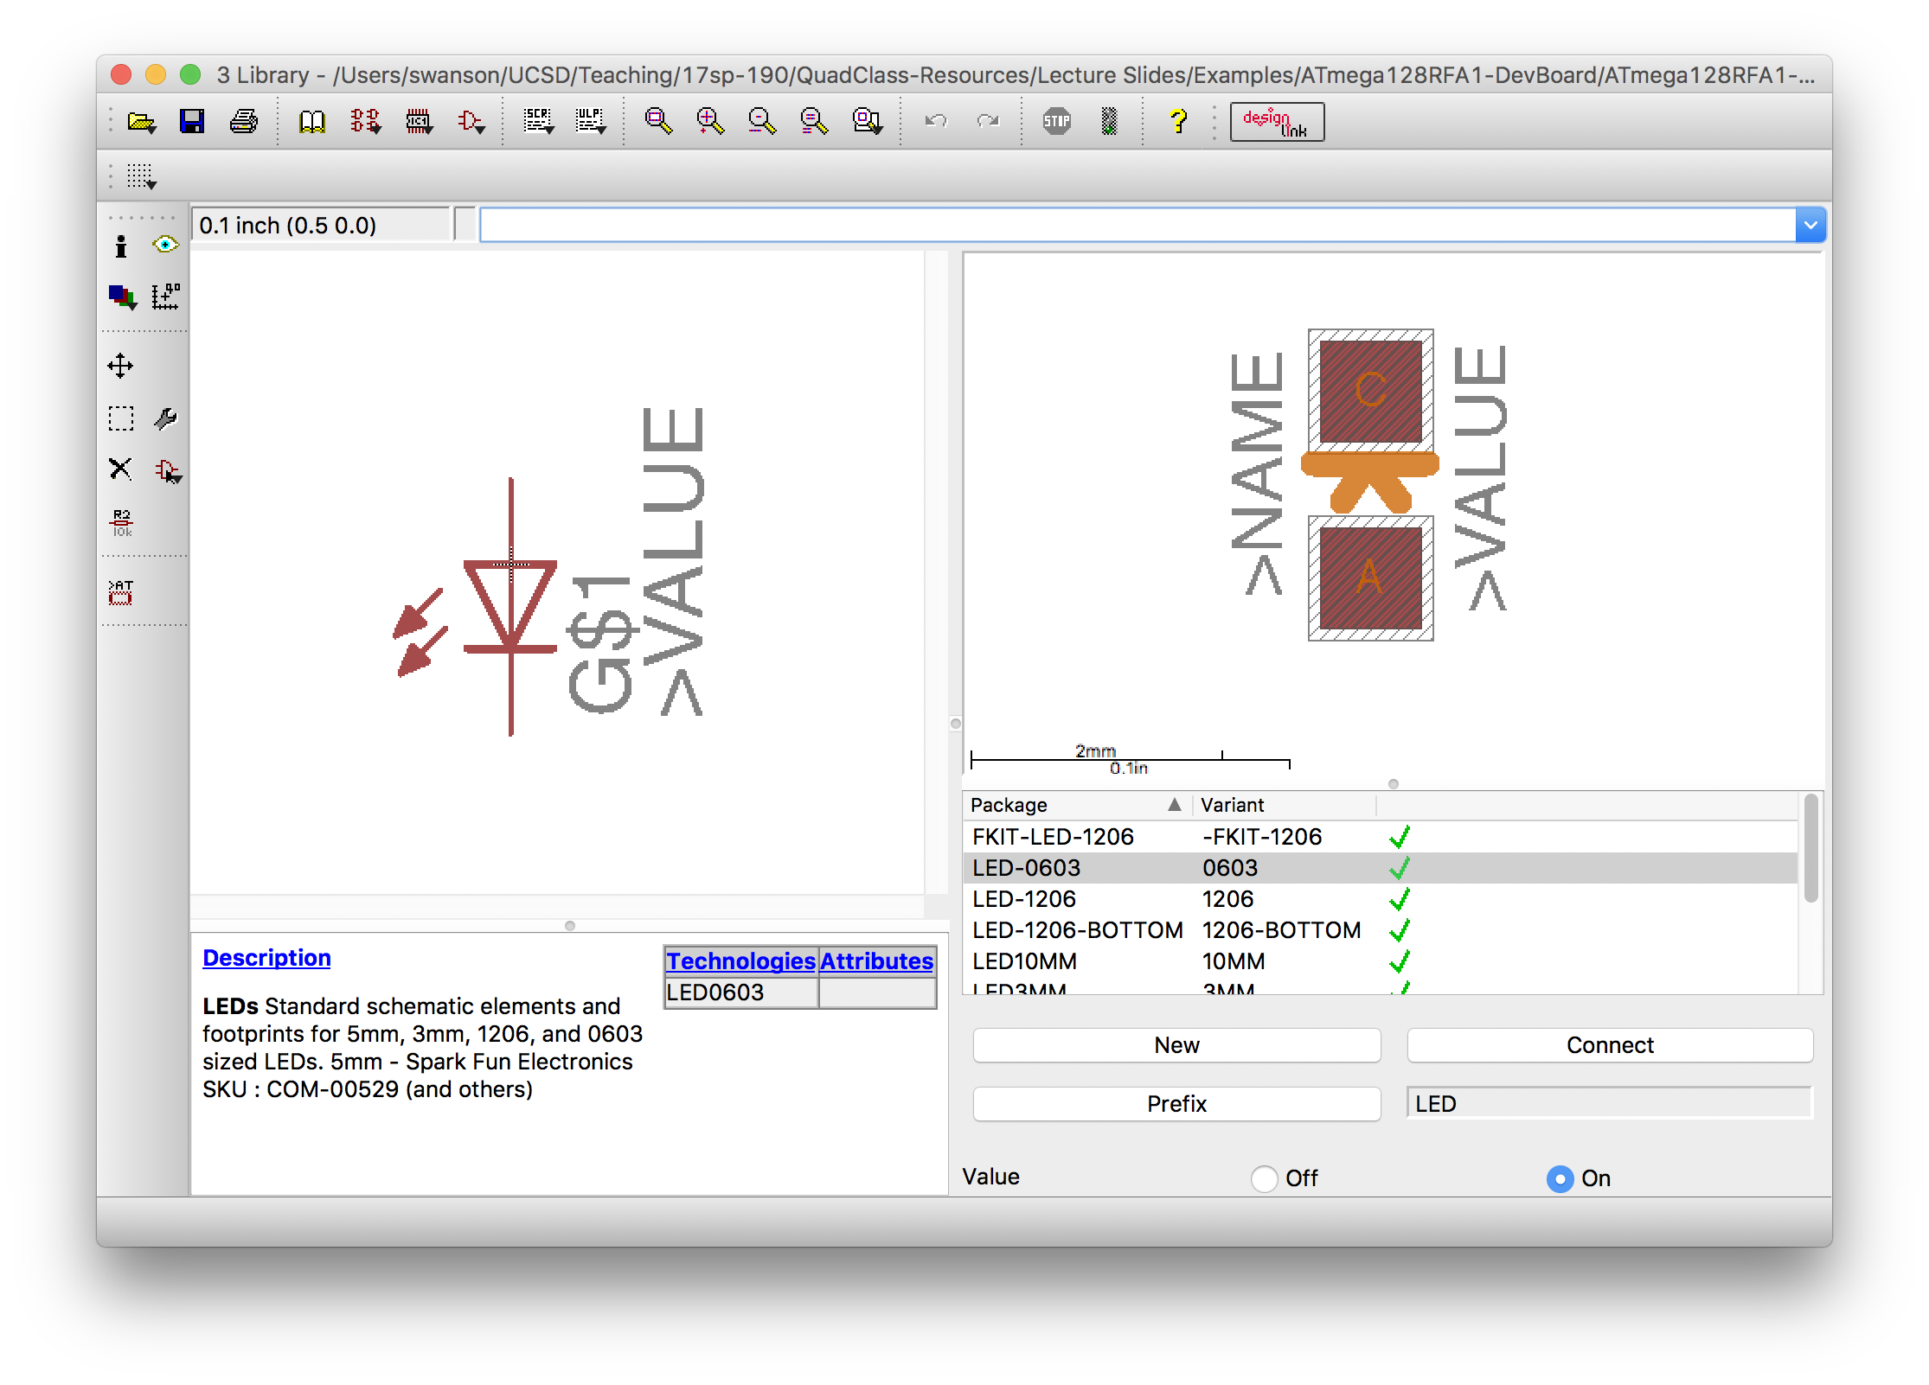
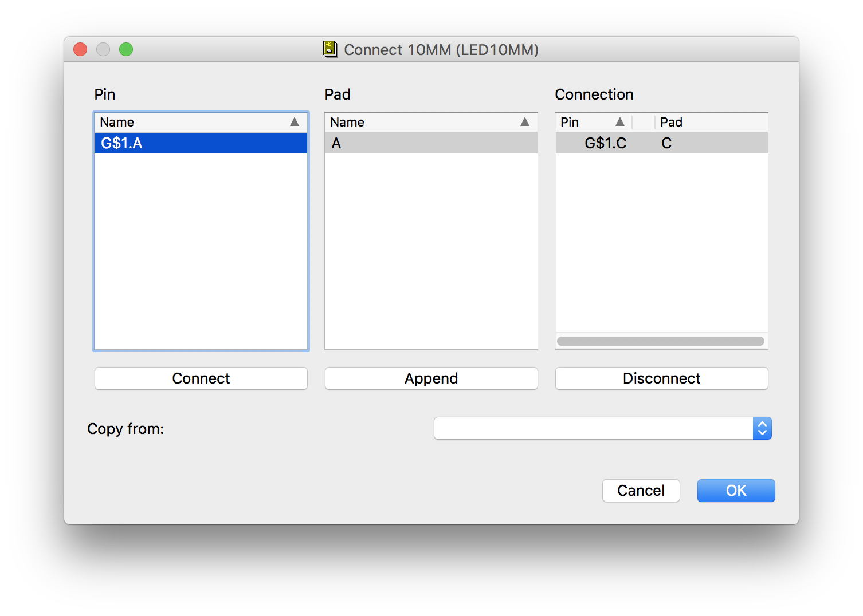
Devices in Eagle

Slide 25
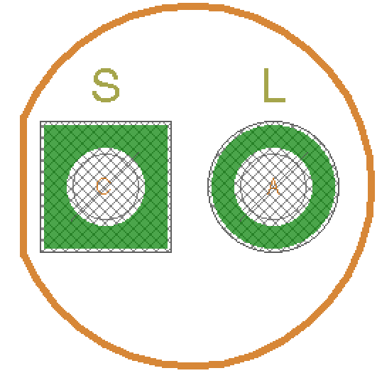
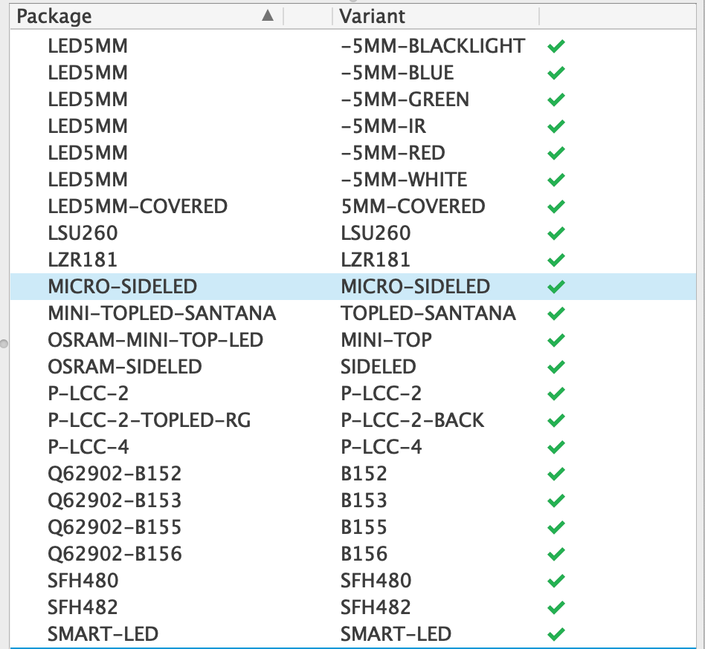
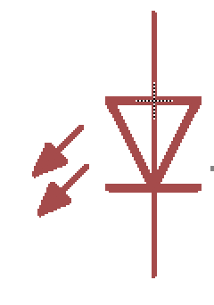
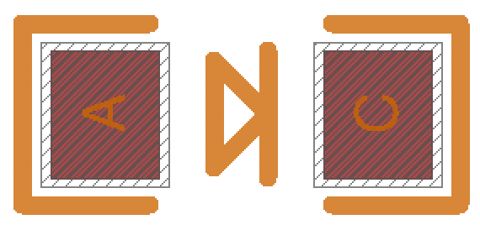
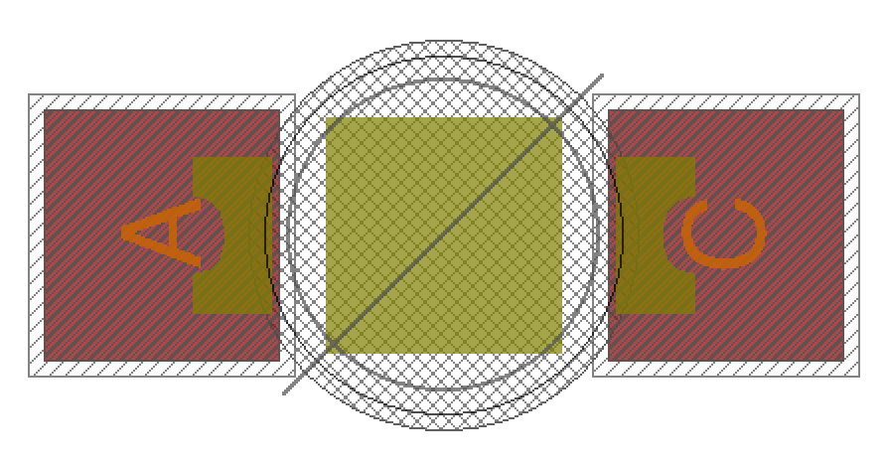
Device Example: LED
One Symbol
Many Packages
Many Variants

Slide 26
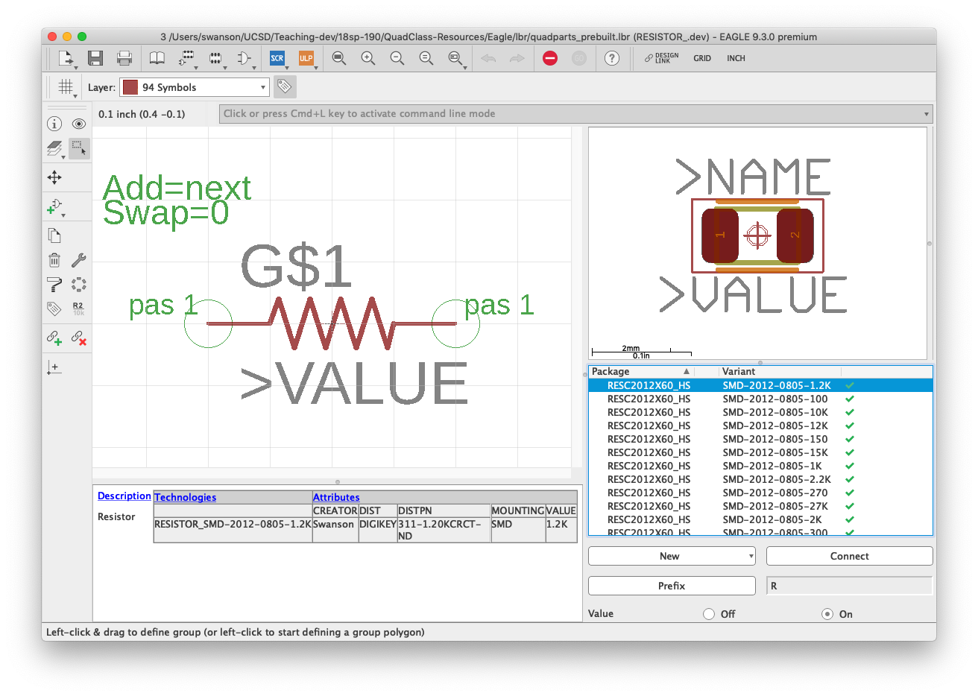
Example: A Resistor
The Device
Maps the symbol to the package
There can be multiple “variants”
Different packages
Same symbol
Same kind of device

Slide 27
Pads and SMDs
There are two types of connections between a PCB and a part
“through holes” – Usually called “through holes”
“Surface mount” – Usually called “pads” on “lands”
Eagle uses odd terminology
”Pads” are through hole connections
SMD (surface mount device) are surface mount connections.

Slide 28
The Parts
Resistor
LED
MOSFET
IMU

Slide 29
Datasheets
Datasheets describe electronic component.
Capabilities
Mechanical information
Size
Recommended board layout
Pin location
Electrical information
Input/output voltages
Additional required components
Schematic Applications
Examples of how to connect the part electrically
Processing information
Reflow soldering requirements
Packaging information

Slide 30
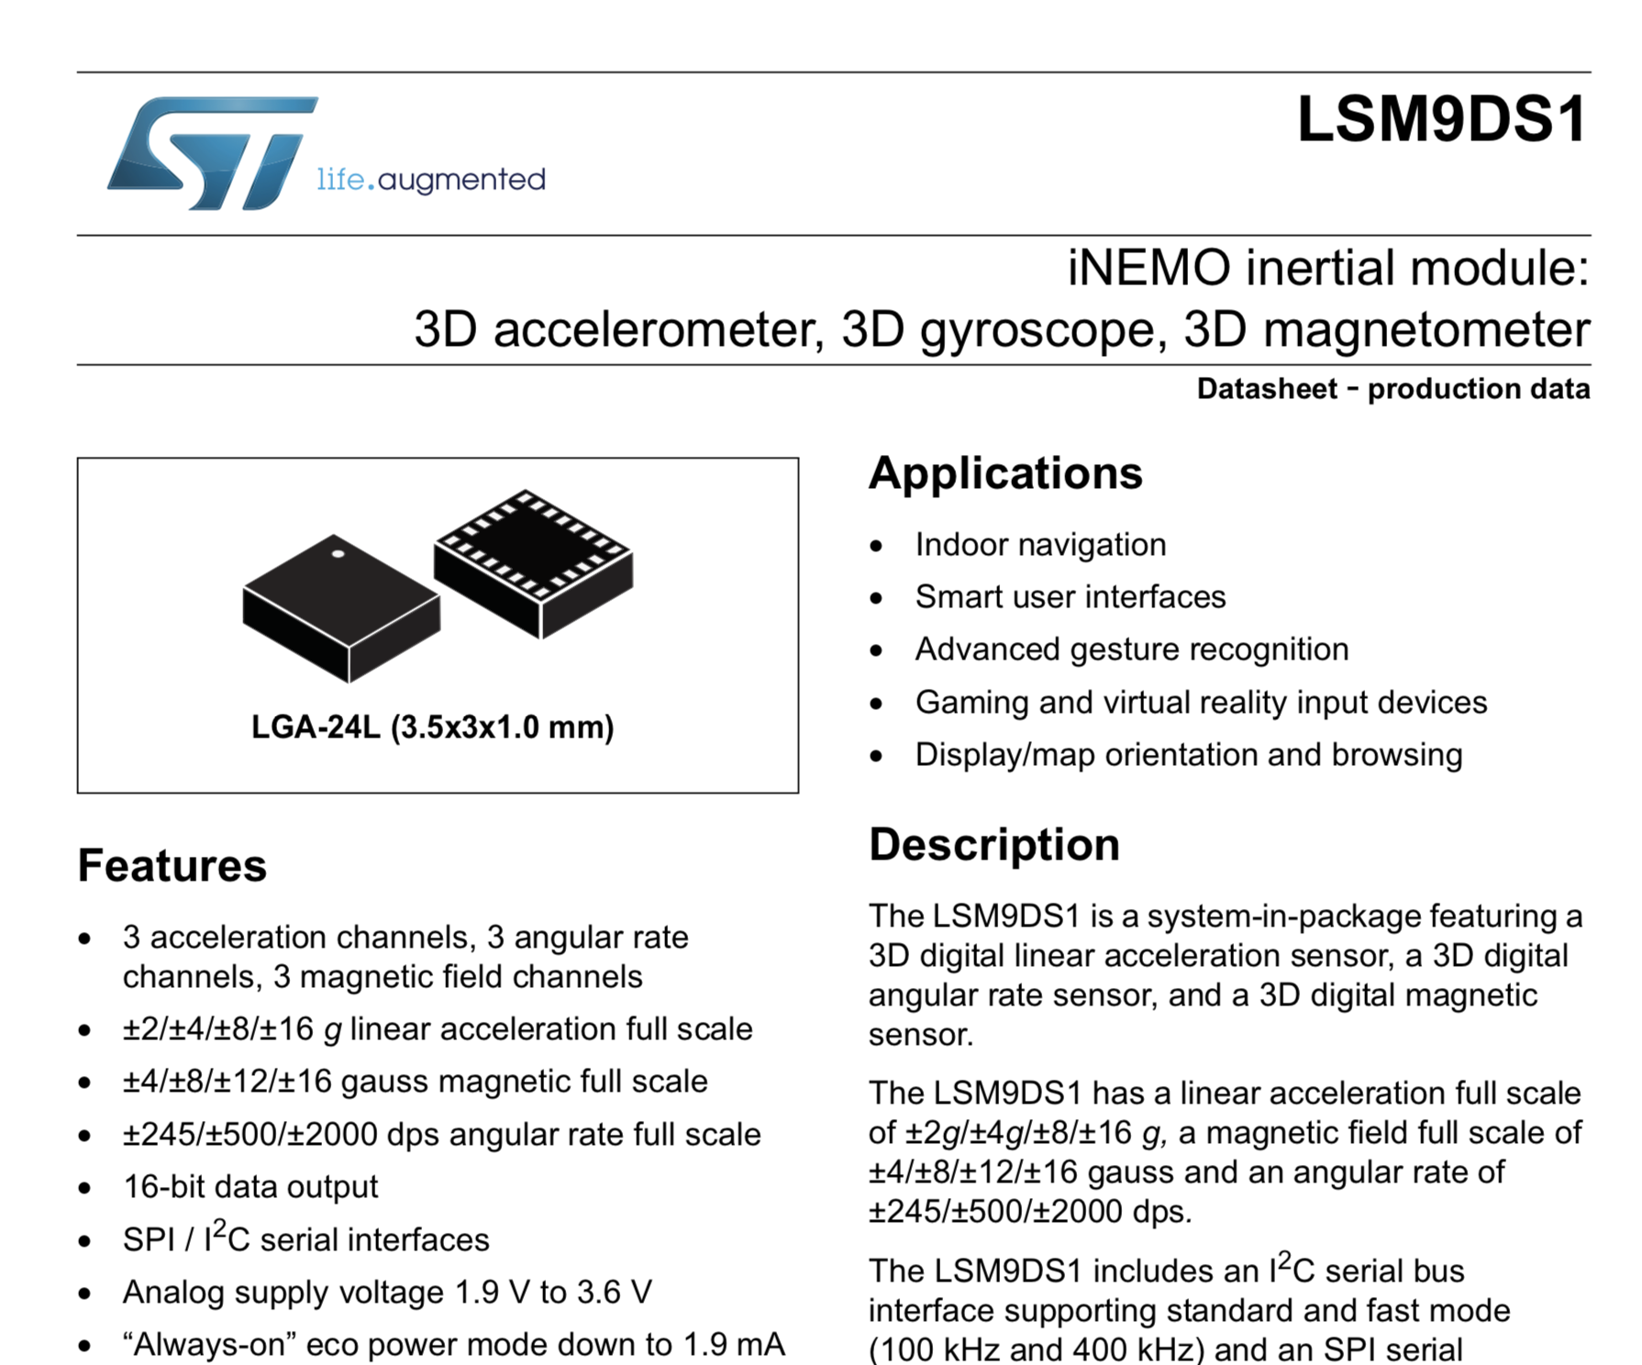

Slide 31
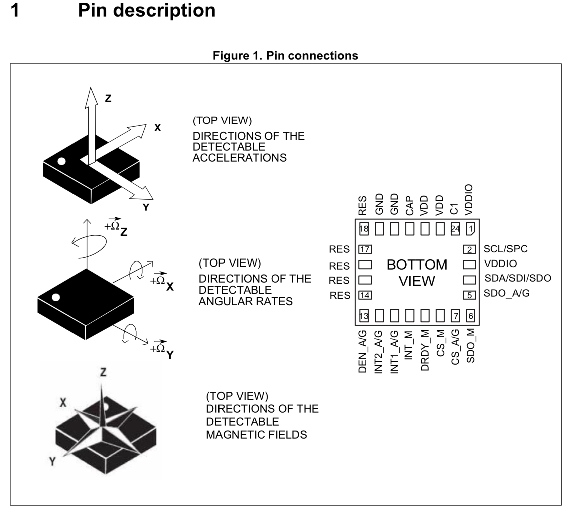

Slide 32
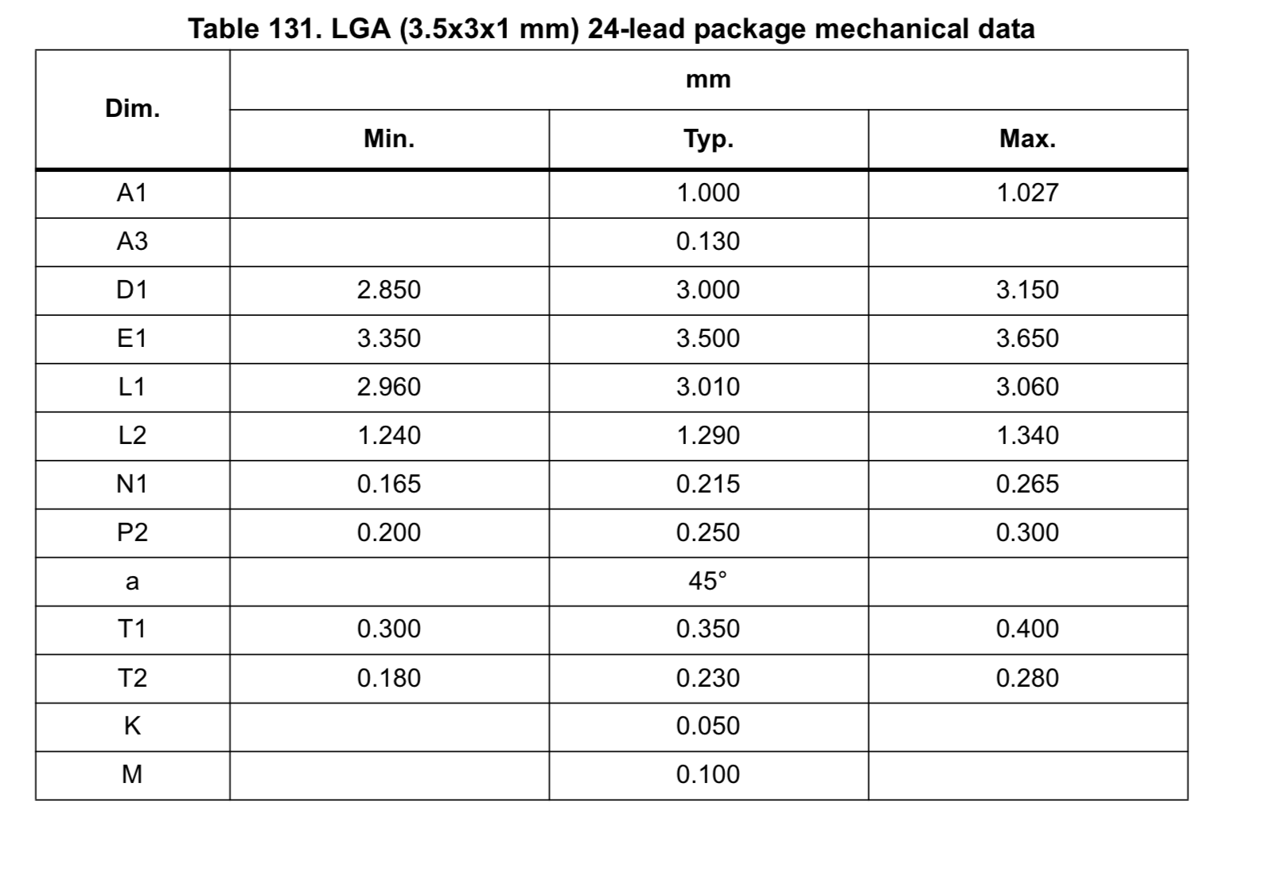
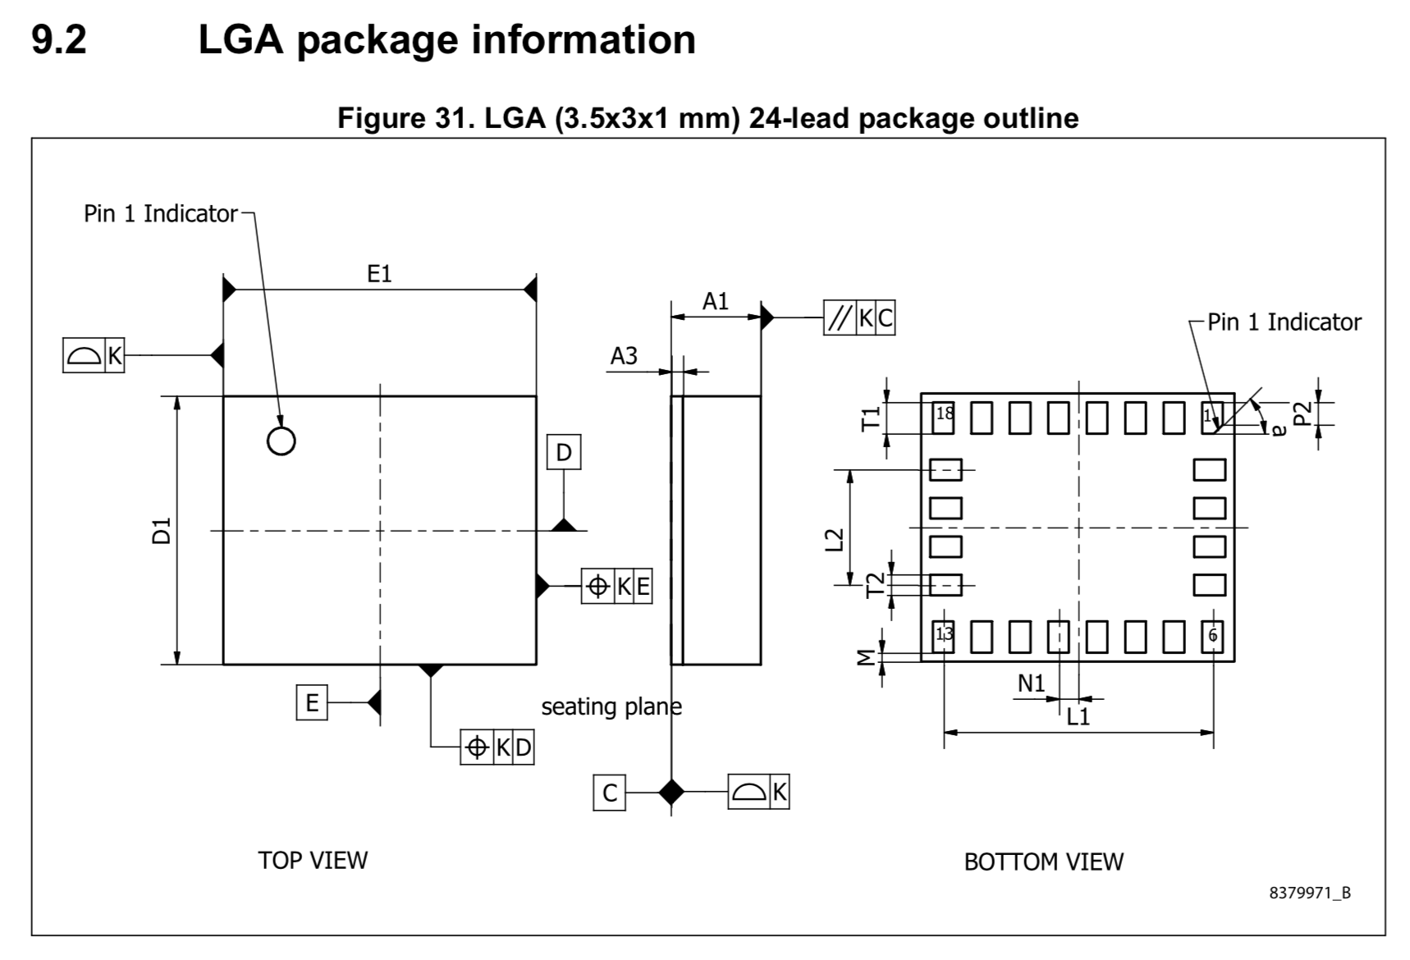

Slide 33
Tech Notes
More detailed information on some aspect of a part.
They will usually be referenced in the data sheet.
Sometimes, you just need to go looking for them.

Slide 34
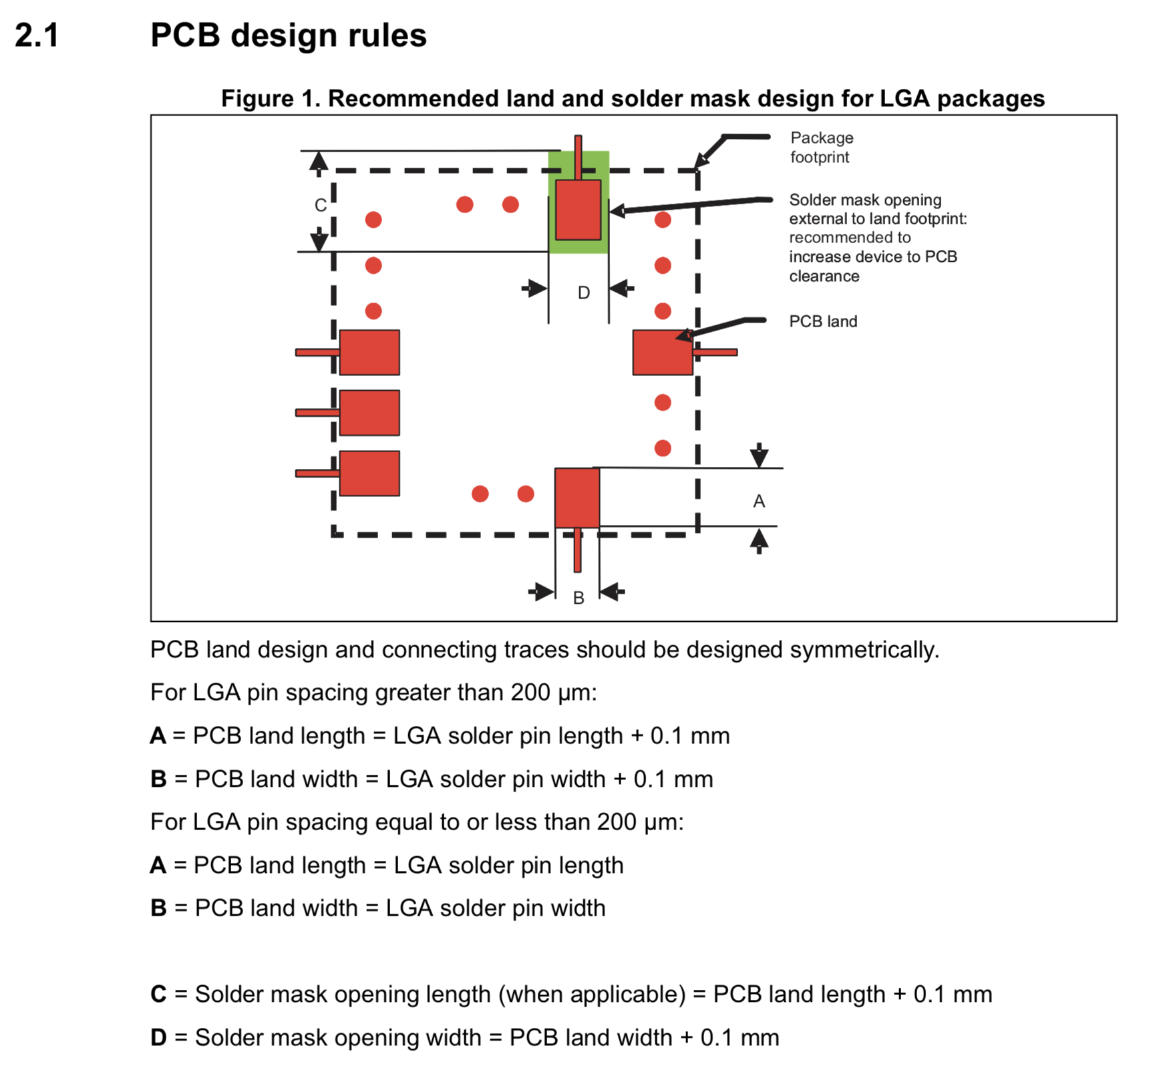

Slide 35
The LEDs
Draw an appropriate symbol (look online for examples)
Pay careful attention to orientation.
Do not confuse the cathode and the anode
Correct orientation should be clear on the schematic symbol and the package.

Slide 36
MOSFET
Symbol
It’s an NMOS transistor
Use google to find an appropriate symbol
Make sure you get the source and drain correct (follow the datasheet)
Package
We need large metal pads for thermal reasons
But small pads.
Pads with large metal/small solder mask opening

Slide 37
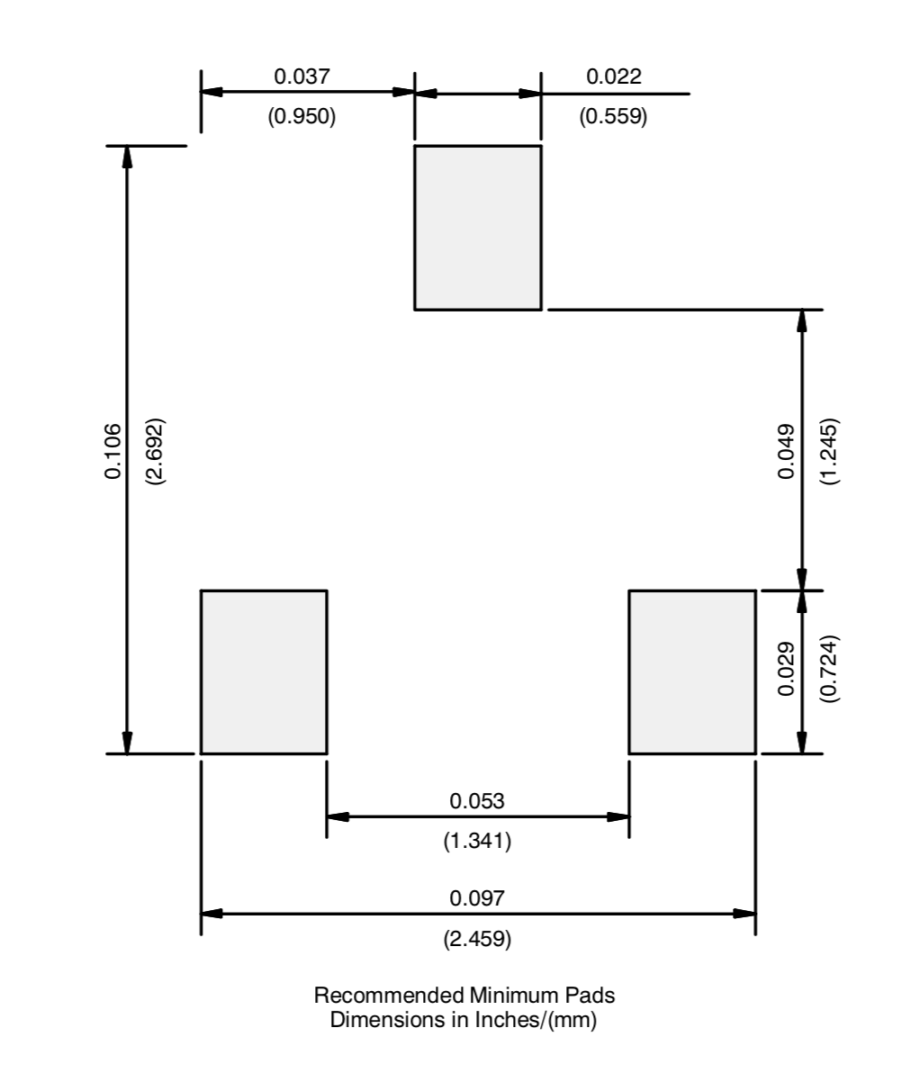
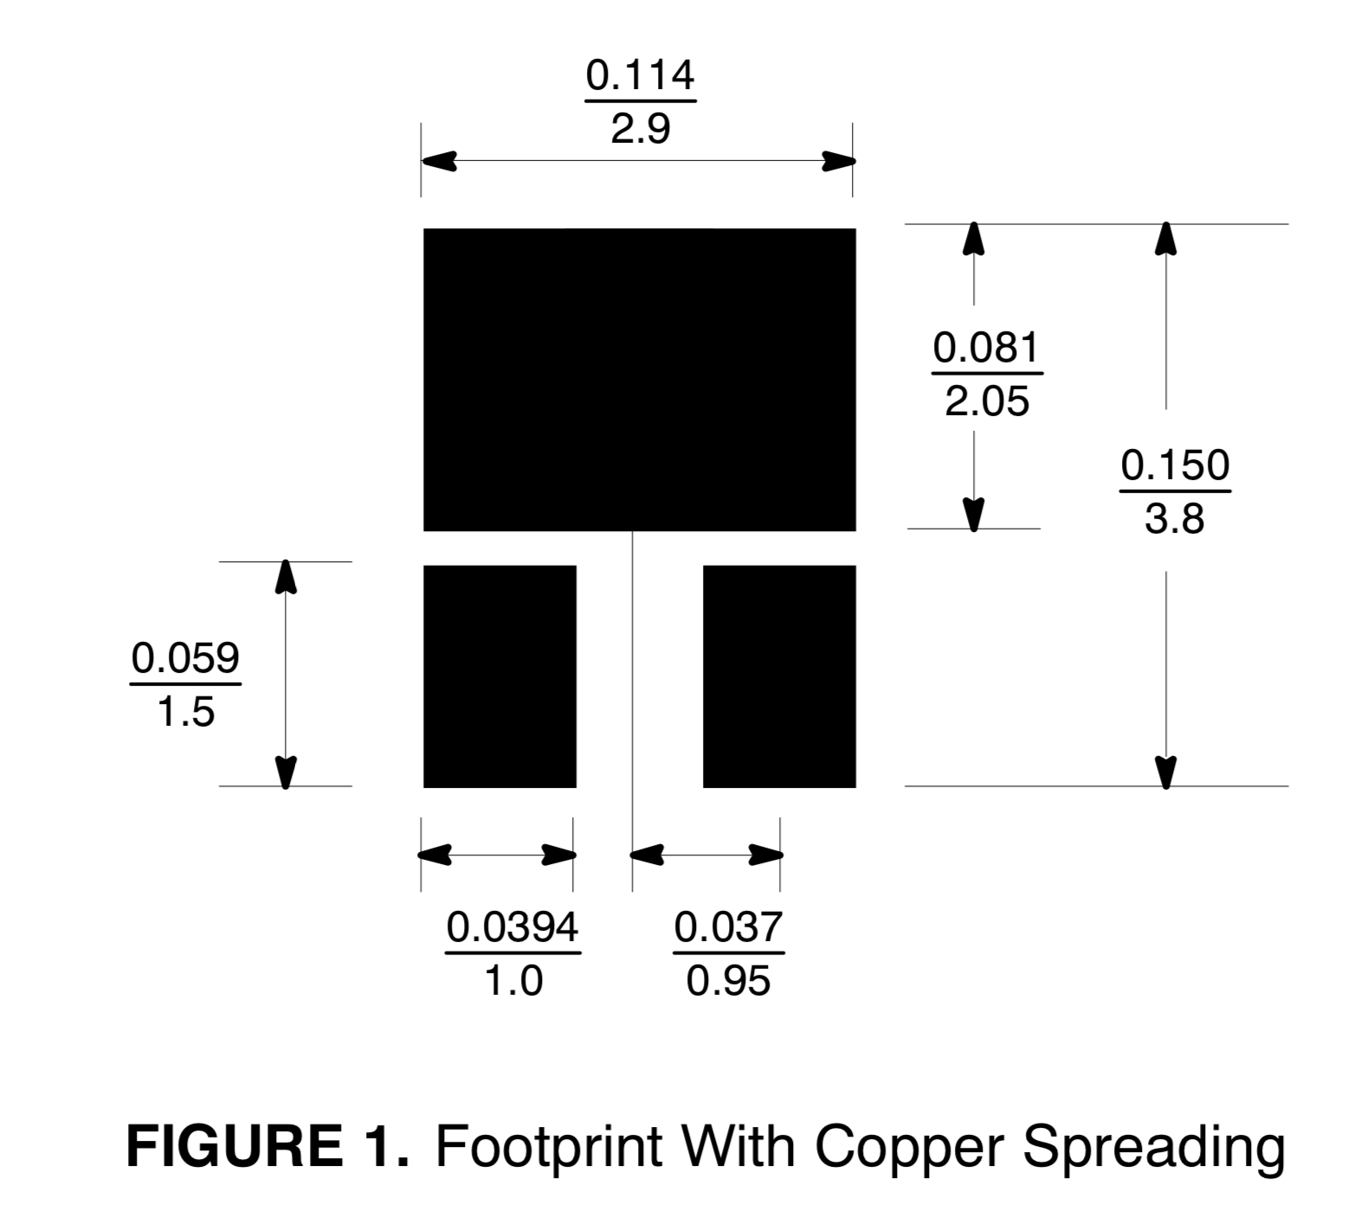
MOSFET Pad guidance in the datasheet

Slide 38
Demo and Lab Walk Through
Mosfet
Symbol
Package
Device
IMU
Symbol
Package
Device

